Slide 1
LGBTQ BOOK DISPLAY
LIS 600: Foundation of Libraries/Information Studies
Assignment 2: Advocacy/Ethics Project
Wilson Mericle

Slide 2

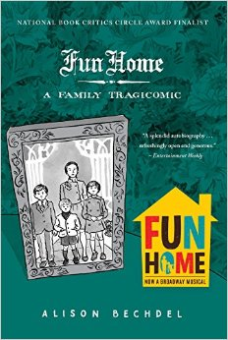
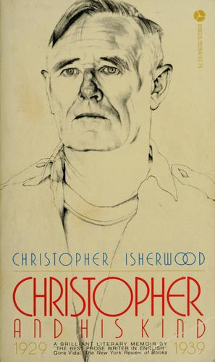
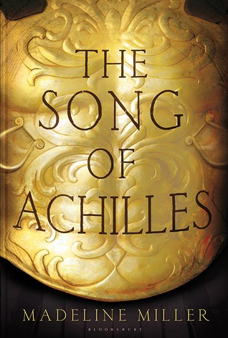
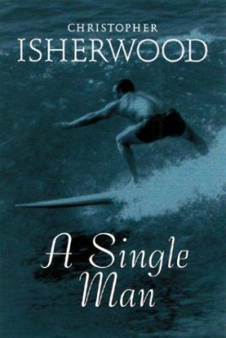
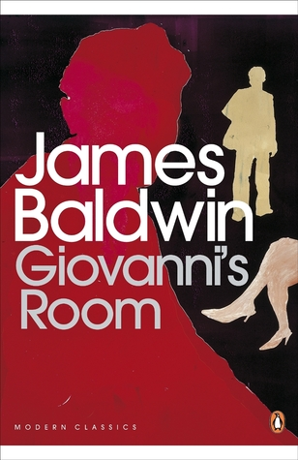

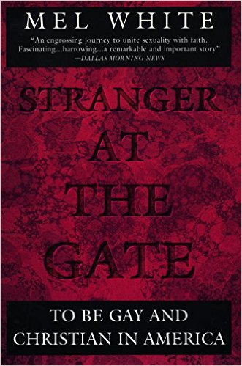
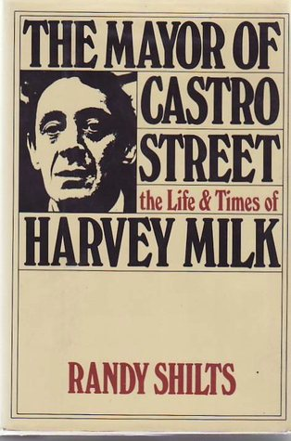



Slide 3
Nonfiction

Slide 4


Slide 5

Christopher and His Kind
Christopher and His Kind covers the most memorable ten years in the writer’s life—from 1929, when Isherwood left England to spend a week in Berlin and decided to stay there indefinitely, to 1939, when he arrived in America. When the book was published in 1976, readers were deeply impressed by the courageous candor with which he describes his life in gay Berlin of the 1930s and his struggles to save his companion, Heinz, from the Nazis.
An engrossing and dramatic story and a fascinating glimpse into a little-known world, Christopher and His Kind remains a classic in gay liberation literature and one of Isherwood’s greatest achievements.
(amazon.com)

Slide 7
Fun Home
This book takes its place alongside the unnerving, memorable, darkly funny family memoirs of Augusten Burroughs and Mary Karr. It's a father-daughter tale perfectly suited to the graphic memoir form. Meet Alison's father, a historic preservation expert and obsessive restorer of the family's Victorian house, a third-generation funeral home director, a high school English teacher, an icily distant parent, and a closeted homosexual who, as it turns out, is involved with male students and a family babysitter. Through narrative that is alternately heartbreaking and fiercely funny, we are drawn into a daughter's complex yearning for her father. And yet, apart from assigned stints dusting caskets at the family-owned 'fun home, ' as Alison and her brothers call it, the relationship achieves its most intimate expression through the shared code of books. When Alison comes out as homosexual herself in late adolescence, the denouement is swift, graphic, and redemptive.--From publisher description.
(WorldCat)

Slide 9
The Mayor of Castro Street
The Mayor of Castro Street is Shilts's acclaimed story of Harvey Milk, the man whose personal life, public career, and tragic assassination mirrored the dramatic and unprecedented emergence of the gay community in America during the 1970s. His is a story of personal tragedies and political intrigues, assassination in City Hall and massive riots in the streets, the miscarriage of justice and the consolidation of gay power and gay hope.
(amazon.com)

Slide 11
Stranger At The Gate
Until Christmas Eve 1991, Mel White was regarded by the leaders of the religious right as one of their most talented and productive supporters. He penned the speeches of Ollie North. He was a ghostwriter for Jerry Falwell, worked with Jim Bakker, flew in Pat Robertson's private jet, walked sandy beaches with Billy Graham. What these men didn't know was that Mel White—evangelical minister, committed Christian, family man—was gay.In this remarkable book, Mel White details his twenty-five years of being counseled, exorcised, electric-shocked, prayed for, and nearly driven to suicide because his church said homosexuality was wrong. But his salvation—to be openly gay and Christian—is more than a unique coming-out story. It is a chilling exposé that goes right into the secret meetings and hidden agendas of the religious right. Told by an eyewitness and sure to anger those Mel White once knew best, Stranger at the Gate is a warning about where the politics of hate may lead America … a brave book by a good man whose words can make us richer in spirit and much wiser too.
(amazon.com)

Slide 13
Whipping Girl
A provocative manifesto, Whipping Girl tells the powerful story of Julia Serano, a transsexual woman whose supremely intelligent writing reflects her diverse background as a lesbian transgender activist and professional biologist. Serano shares her experiences and observations—both pre- and post-transition—to reveal the ways in which fear, suspicion, and dismissiveness toward femininity shape our societal attitudes toward trans women, as well as gender and sexuality as a whole.
Serano's well-honed arguments stem from her ability to bridge the gap between the often-disparate biological and social perspectives on gender. She exposes how deep-rooted the cultural belief is that femininity is frivolous, weak, and passive, and how this “feminine” weakness exists only to attract and appease male desire.
In addition to debunking popular misconceptions about transsexuality, Serano makes the case that today's feminists and transgender activist must work to embrace and empower femininity—in all of its wondrous forms.
(amazon.com)

Slide 14
Fiction

Slide 16
Giovanni’s Room
Baldwin's haunting and controversial second novel is his most sustained treatment of sexuality, and a classic of gay literature. In a 1950s Paris swarming with expatriates and characterized by dangerous liaisons and hidden violence, an American finds himself unable to repress his impulses, despite his determination to live the conventional life he envisions for himself. After meeting and proposing to a young woman, he falls into a lengthy affair with an Italian bartender and is confounded and tortured by his sexual identity as he oscillates between the two.
Examining the mystery of love and passion in an intensely imagined narrative, Baldwin creates a moving and complex story of death and desire that is revelatory in its insight.
(goodreads.com)

Slide 18
Lies We Tell Ourselves
In 1959 Virginia, the lives of two girls on opposite sides of the battle for civil rights will be changed forever.
Sarah Dunbar is one of the first black students to attend the previously all-white Jefferson High School. An honors student at her old school, she is put into remedial classes, spit on and tormented daily.
Linda Hairston is the daughter of one of the town's most vocal opponents of school integration. She has been taught all her life that the races should be kept "separate but equal."
Forced to work together on a school project, Sarah and Linda must confront harsh truths about race, power and how they really feel about one another.
Boldly realistic and emotionally compelling, Lies We Tell Ourselves is a brave and stunning novel about finding truth amid the lies, and finding your voice even when others are determined to silence it.
(amazon.com)

Slide 19


Slide 20
More Happy Than Not
After enduring his father's suicide, his own suicide attempt, broken friendships, and more in the Bronx projects, Aaron Soto, sixteen, is already considering the Leteo Institute's memory-alteration procedure when his new friendship with Thomas turns to unrequited love.
(WorldCat)

Slide 22
A Single Man
Welcome to sunny suburban 1960s Southern California. George is a gay middle-aged English professor, adjusting to solitude after the tragic death of his young partner. He is determined to persist in the routines of his former life. A Single Man follows him over the course of an ordinary twenty-four hours. Behind his British reserve, tides of grief, rage, and loneliness surge--but what is revealed is a man who loves being alive despite all the everyday injustices.
When Christopher Isherwood's A Single Man first appeared, it shocked many with its frank, sympathetic, and moving portrayal of a gay man in maturity. Isherwood's favorite of his own novels, it now stands as a classic lyric meditation on life as an outsider.
(amazon.com)

Slide 24
The Song of Achilles
Greece in the age of heroes. Patroclus, an awkward young prince, has been exiled to the court of King Peleus and his perfect son Achilles. Despite their difference, Achilles befriends the shamed prince, and as they grow into young men skilled in the arts of war and medicine, their bond blossoms into something deeper - despite the displeasure of Achilles' mother Thetis, a cruel sea goddess. But when word comes that Helen of Sparta has been kidnapped, Achilles must go to war in distant Troy and fulfill his destiny. Torn between love and fear for his friend, Patroclus goes with him, little knowing that the years that follow will test everything they hold dear.
(goodreads.com)

